Slide 1
Conway’s Game of Life
The cdm-8 project
made by Martynov B & Belov D
23217
{01}
{04}
Introduction
Hardware
{02}
{05}
Problem Statement
Software
{03}
{06}
User guide
Conclusion

Slide 2
Table of contents
{04}
{02}
{05}
{03}
{06}
Conway’s Game of Life
The cdm-8 project
made by Martynov B & Belov D
23217
{01}
Introduction
Hardware
Problem Statement
Software
User guide
Conclusion
{01}
Introduction

Slide 3
{01}
Introduction
Table of contents
{01}
{04}
Introduction
Hardware
{02}
{05}
Problem Statement
Software
{03}
{06}
User guide
Conclusion
Rules
Neighbours are nearby cells (like a king in chess).
3 neighbours — cell can be born.
2 or 3 neighbours — cell continues to live.
Otherwise, the cell dies.

Slide 4
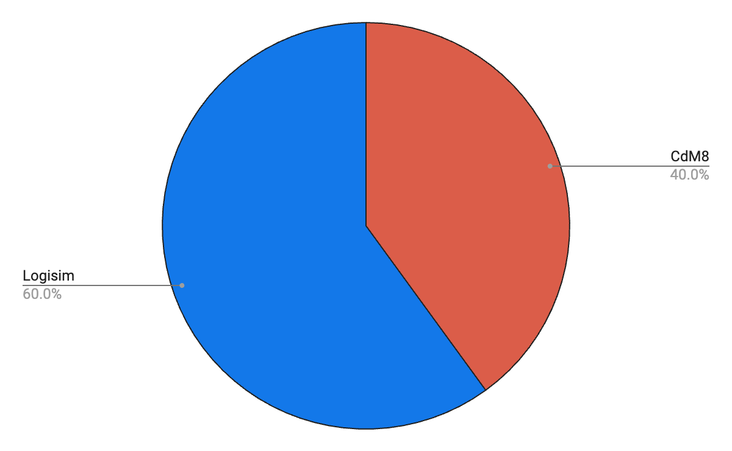
Rules
Neighbours are nearby cells (like a king in chess).
3 neighbours — cell can be born.
2 or 3 neighbours — cell continues to live.
Otherwise, the cell dies.
{01}
Introduction
Logisim & CdM8
Display
System of generation cells
Changing rules
Game Management – Keyboard

Slide 5
Logisim & CdM8
Rules
Neighbours are nearby cells (like a king in chess).
3 neighbours — cell can be born.
2 or 3 neighbours — cell continues to live.
Otherwise, the cell dies.
Logisim
Display
System of generation cells
Changing rules
Cdm8
Game Management – Keyboard
{02}
Problem Statement

Slide 6
{02}
Problem Statement
Logisim & CdM8
Logisim
Display
System of generation cells
Changing rules
Cdm8
Game Management – Keyboard
Subtasks
Divide the project into Logisim part and CdM8 part
Realise Logisim part
Realise CdM8 part
Step 1
Step 2
Step 3
Step 4
Step 5
Step 6
Connect both parts
Optimise it
Realise Check for bags
and fix it part

Slide 7

Subtasks
Divide the project into Logisim part and CdM8 part
Realise Logisim part
Realise CdM8 part
Step 1
Step 2
Step 3
{02}
Step 4
Step 5
Step 6
Problem Statement
Connect both parts
Optimise it
Realise Check for bags
and fix it part
WWW
{03}
Hardware

Slide 8
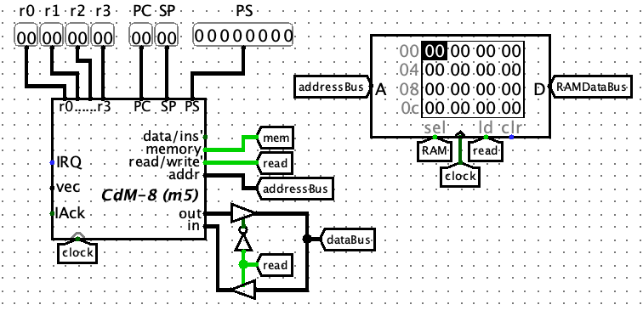
{03}
Hardware
Subtasks
Divide the project into Logisim part and CdM8 part
Realise Logisim part
Realise CdM8 part
Step 1
Step 2
Step 3
Step 4
Step 5
Step 6
Connect both parts
Optimise it
Realise Check for bags
and fix it part
Processor
main.circuit
WWW

Slide 9
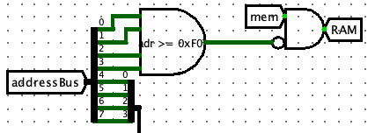
Processor
main.circuit
Read / Write RAM
main.circuit
{03}
Hardware

Slide 10
Read / Write RAM
Processor
main.circuit
main.circuit

Slide 11
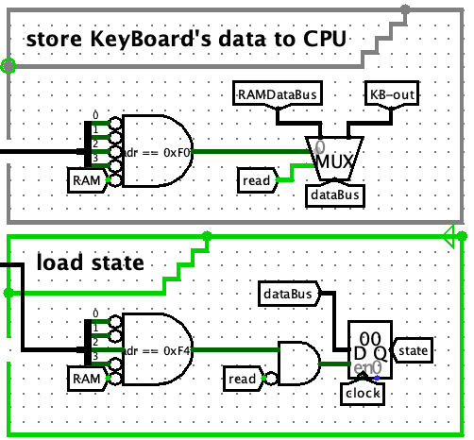
Read / Write RAM
main.circuit

Slide 12
Read / Write RAM
main.circuit

Slide 13
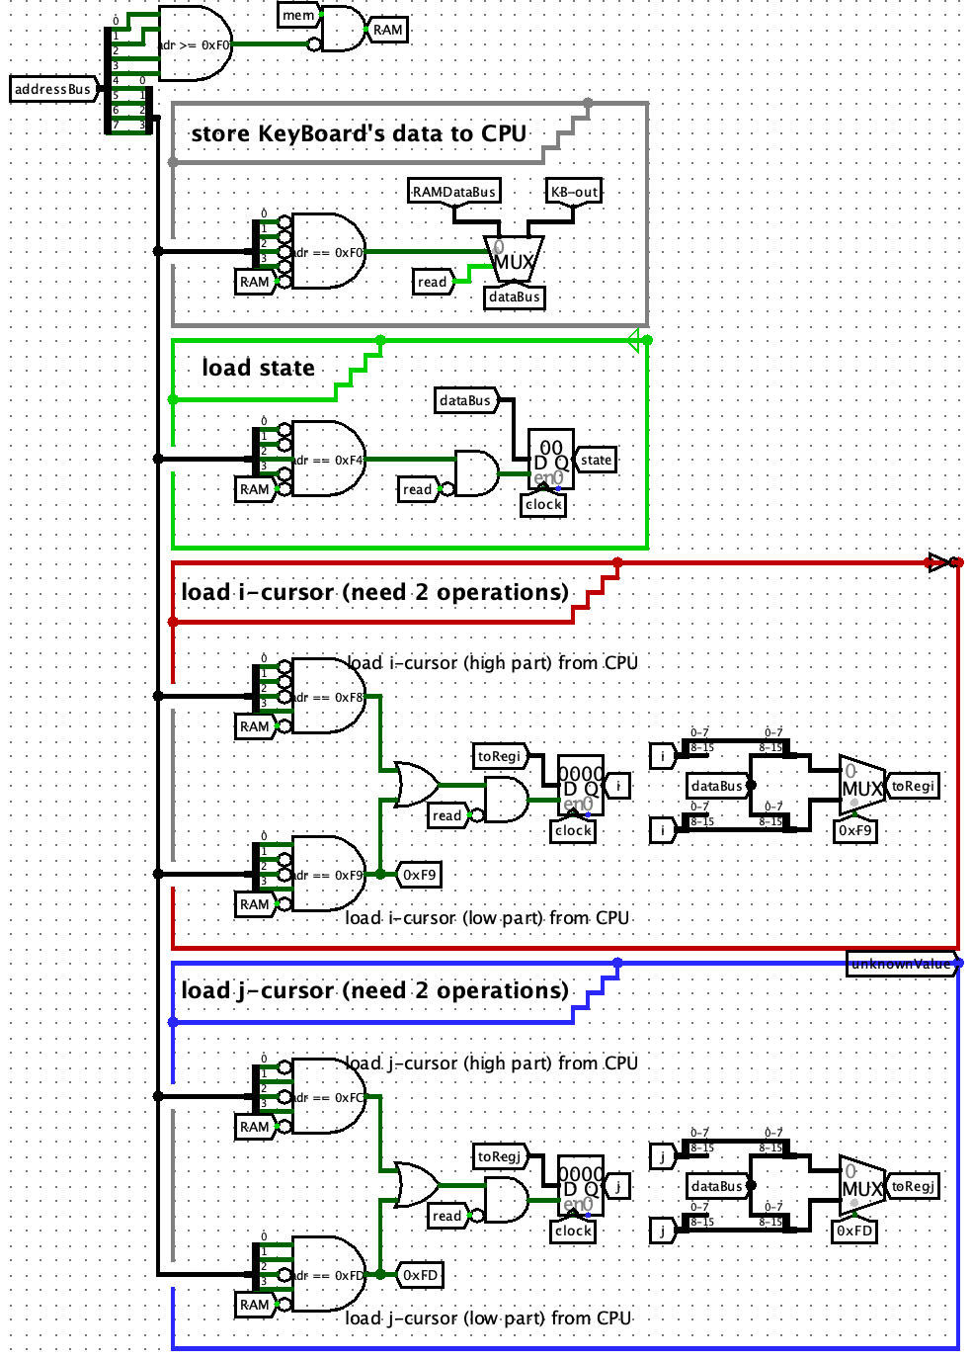
Read / Write RAM
main.circuit

Slide 14
Read / Write RAM
main.circuit

Slide 15
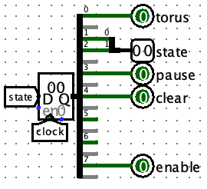
Parser of data
main.circuit

Slide 16
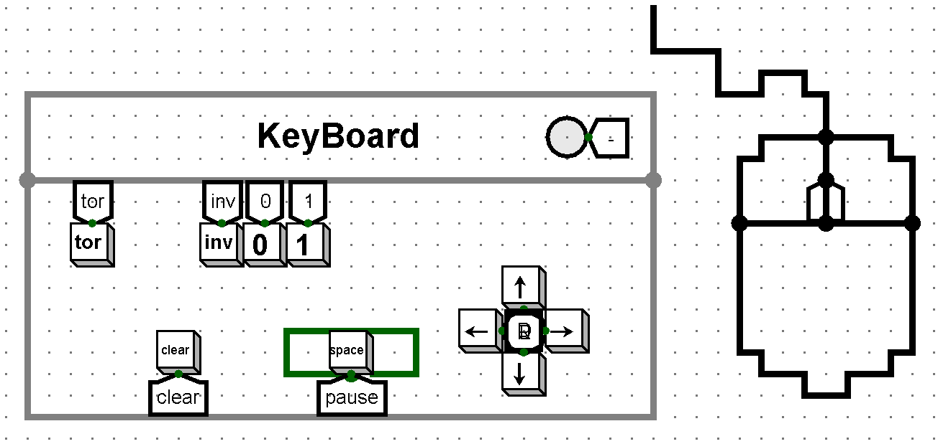
Keyboard
game.circuit

Slide 17
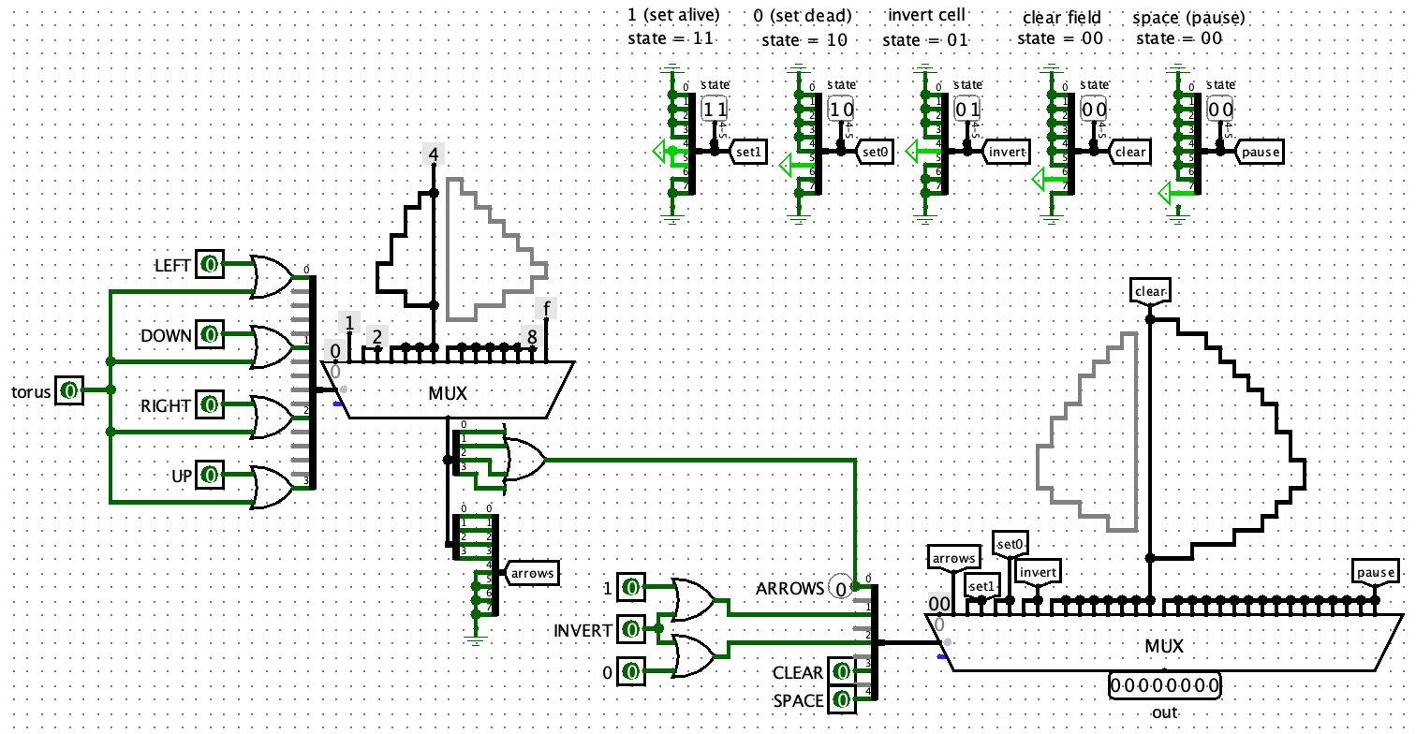
Keyboard
keyboard.circuit

Slide 18
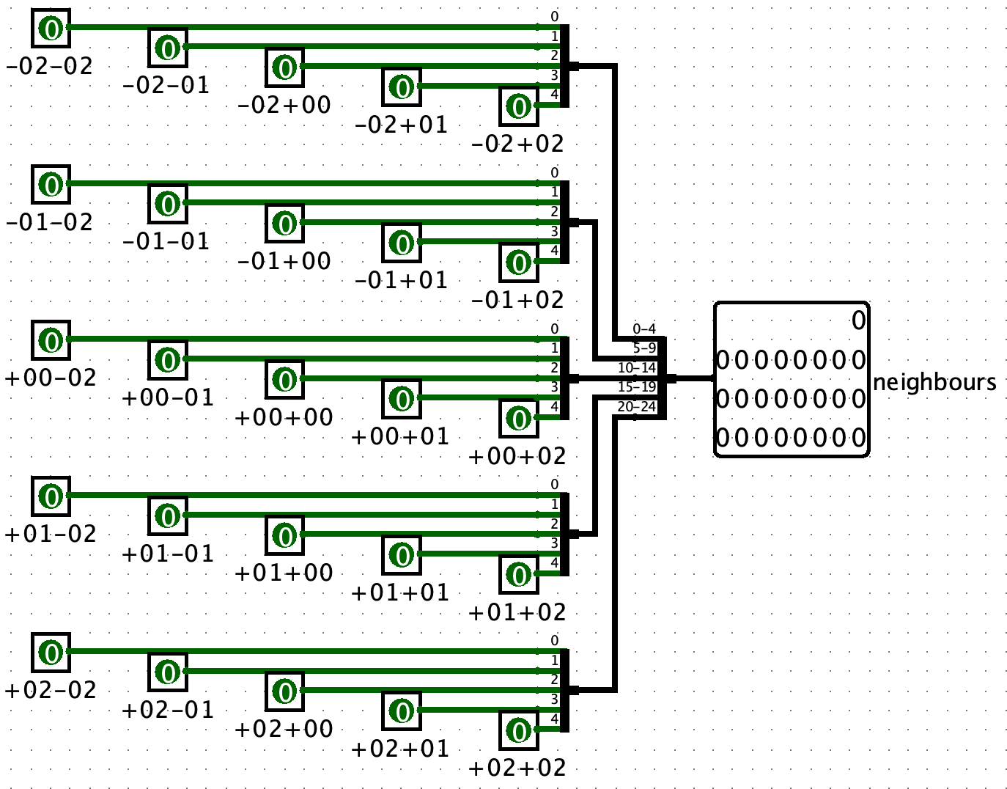
Neighbours
neighbours.circuit

Slide 19
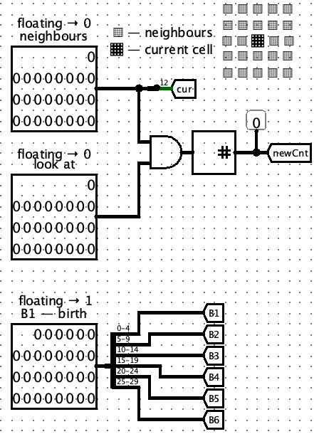
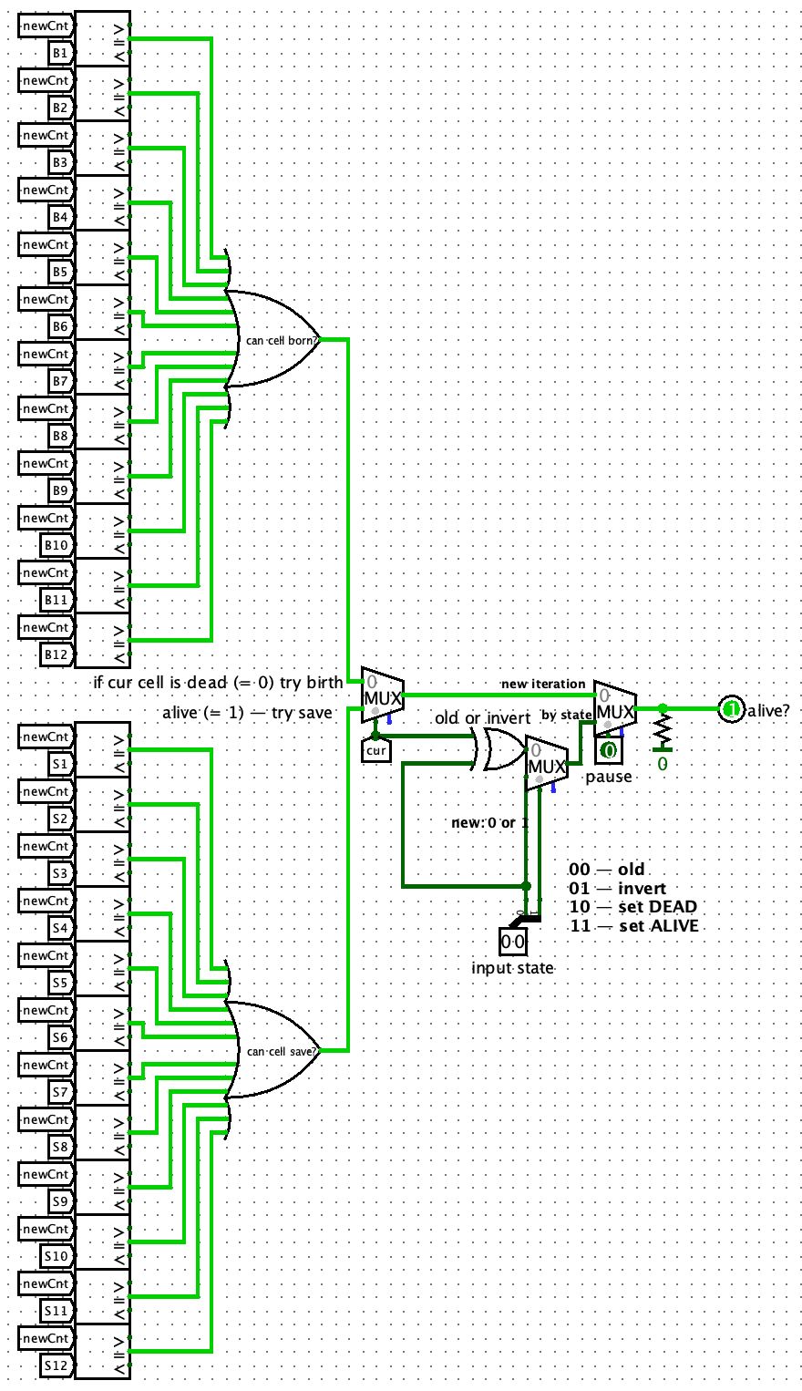
Alive
alive.circuit

Slide 20
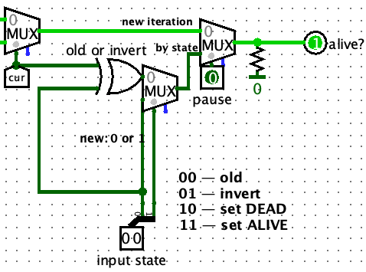
Alive
alive.circuit

Slide 21
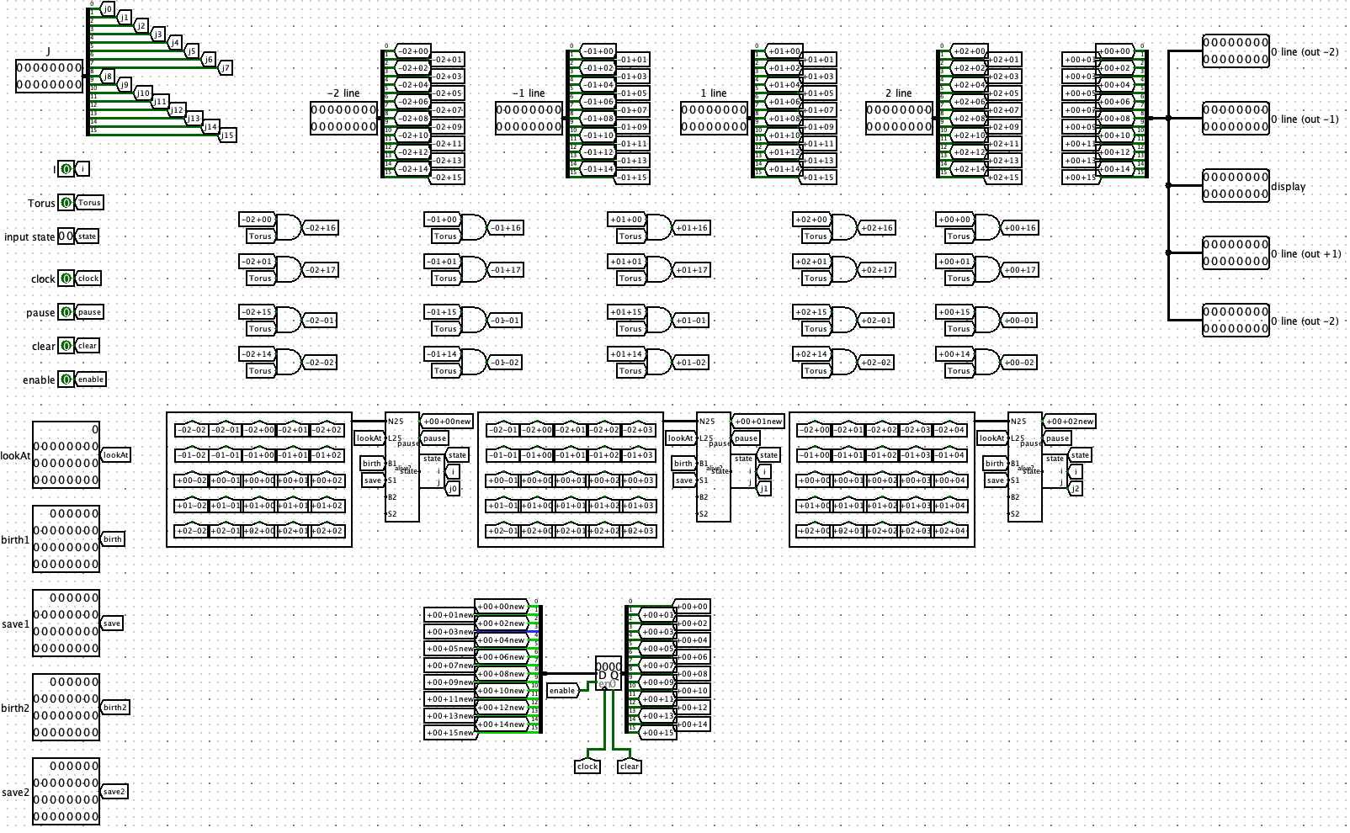
Line
line.circuit

Slide 22
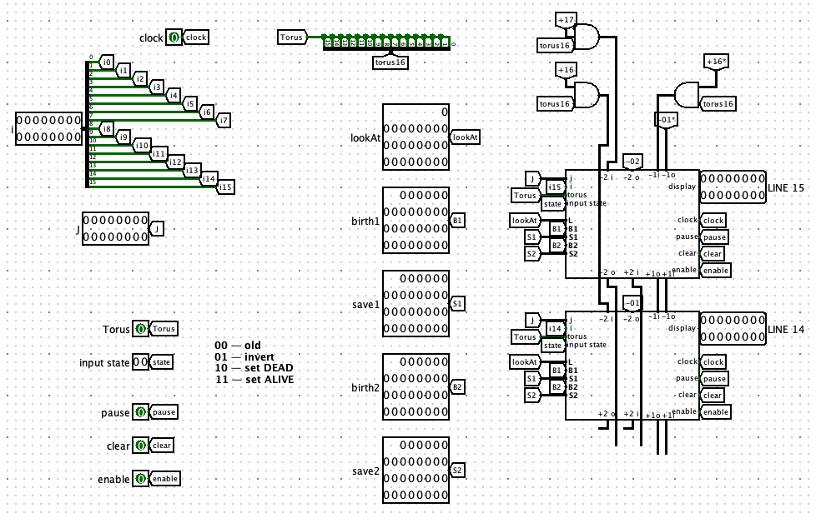
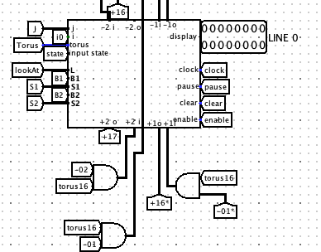
Matrix
matrix.circuit

Slide 23

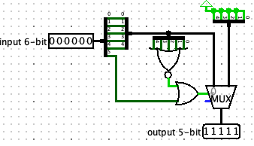
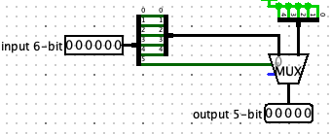
Help Schemes
state-helper.circuit
bs-helper (0->31).circuit
bs-helper.circuit

Slide 24
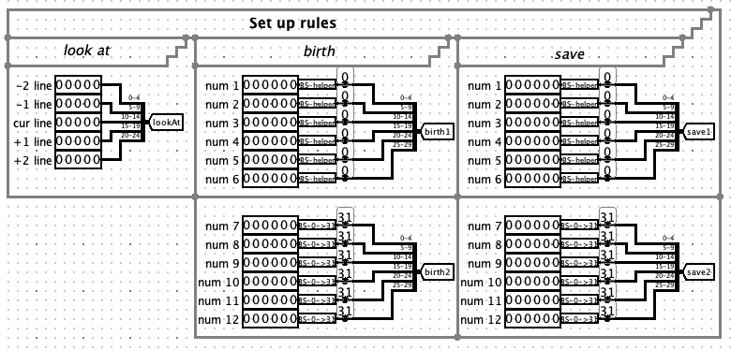
Changes
Rules editor
Cursor for filling filed

Slide 25
Improvements
Keyboard
Toroidal cycled field (torus)

Slide 26
{04}
Software

Slide 27
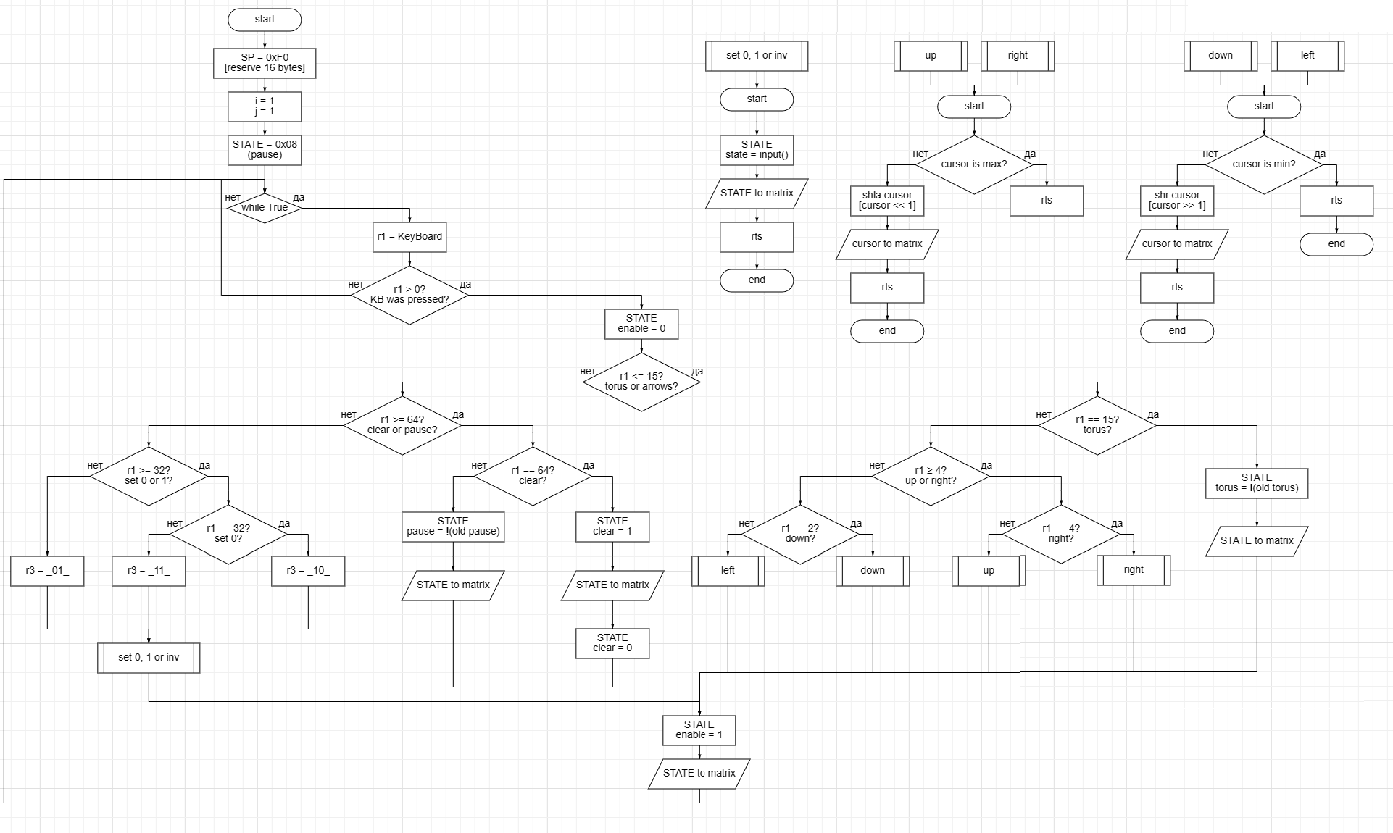

Slide 28

Conclusion
Martynov B & Belov D , 23217

